Slide 1
Crowdfunding Analytics &
Insights Dashboard

Slide 2
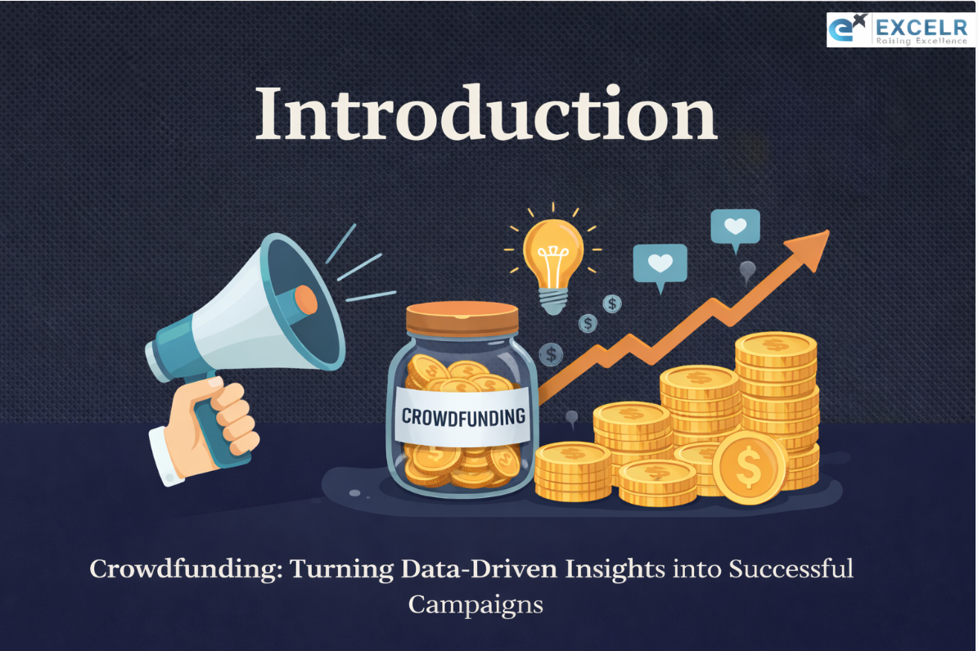
Crowdfunding
Crowdfunding is the practice of funding a project or venture by raising small amounts of money from a large number of people, typically via the Internet. Crowdfunding is a form of crowdsourcing and alternative finance. In 2015, over US$34 billion was raised worldwide by crowdfunding.
Kickstarter
Thousands of creative projects are funding on Kickstarter at any given moment. Each project is independently created and crafted by the person behind it. ○ The filmmakers, musicians, artists, and designers you see on Kickstarter have complete control and responsibility over their projects. .

Slide 3
Understanding Crowdfunding Performance Gaps
Objective statements
Key Challenges
Problem Statement
Analyze crowdfunding project performance and success rates.
Inconsistent success rates across project types and categories
What factors influence crowdfunding project success?
Identify top categories, locations, and goal ranges.
Lack of clarity on how funding goals impact success probability
Which categories, locations, and goal ranges perform best?
Limited understanding of high-performing categories and regions

Slide 4
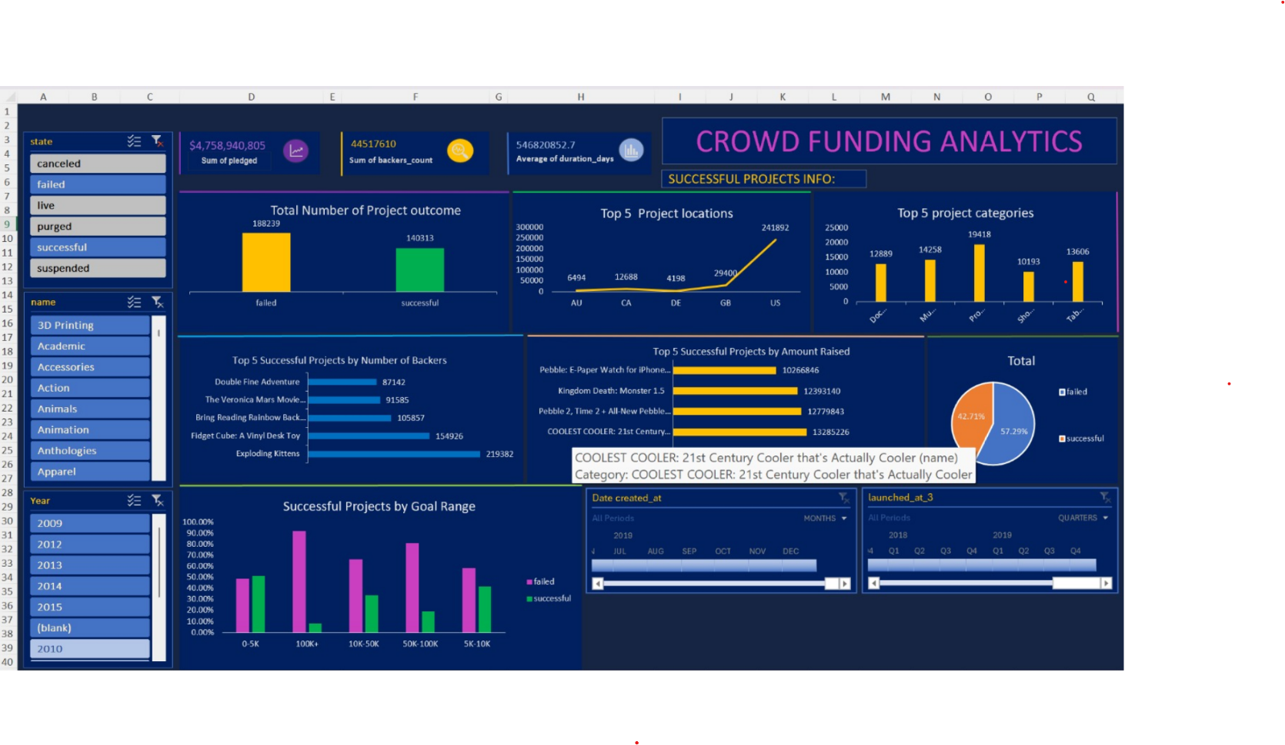
Crowdfunding Analytics –Excel Dashboard Analyzes
.”.

Slide 5
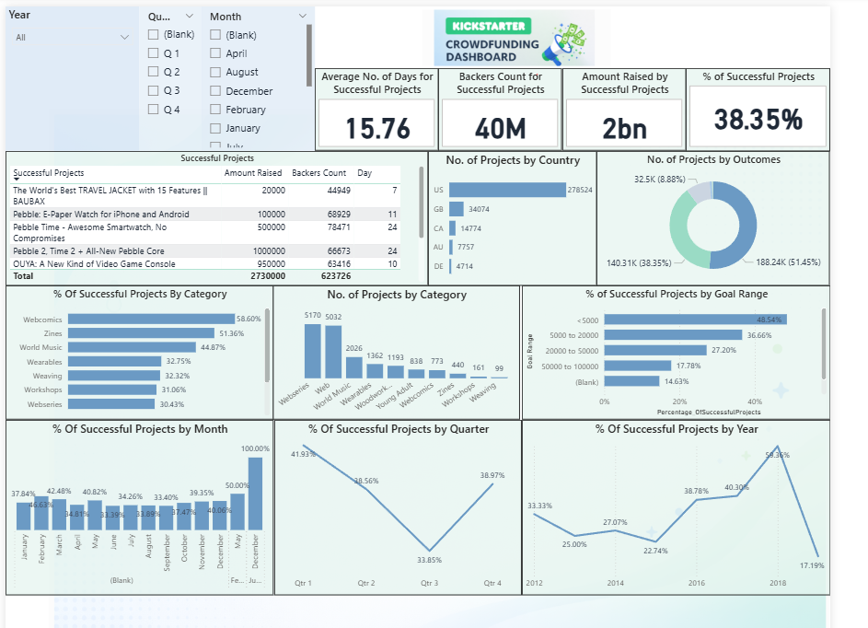
Crowdfunding Data Analytics Dashboard -Power Bi
“Power BI is used to build the main dashboard. We created KPIs like total projects, amount raised, success rate, and average days to success. We used charts, filters, and slicers so users can analyze data by year, country, and category. This helps stakeholders quickly understand project performance.”

Slide 6
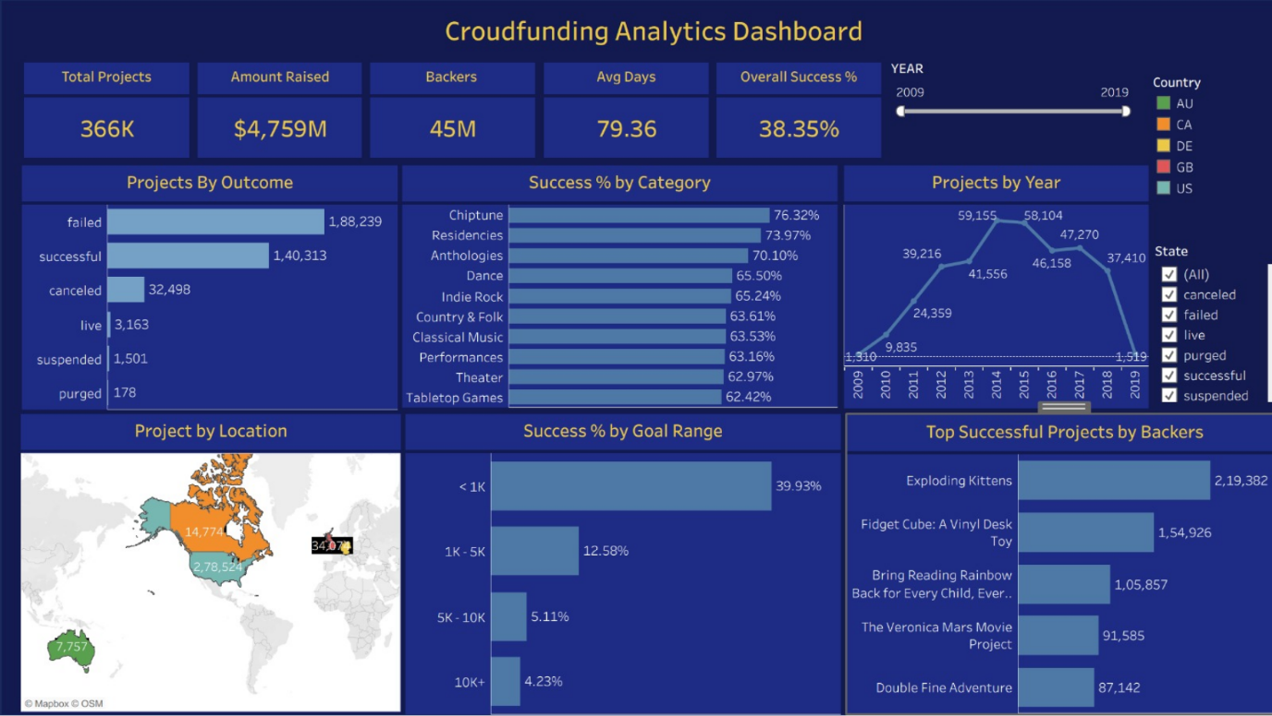
Crowdfunding Analytics –Tableau Dashboard Analyzes
“In Tableau, I created visual reports to analyze trends and patterns .We compared success rates across categories and locations. We also studied how funding changed over different years. This helped us identify top performing projects and growth areas.”

Slide 7
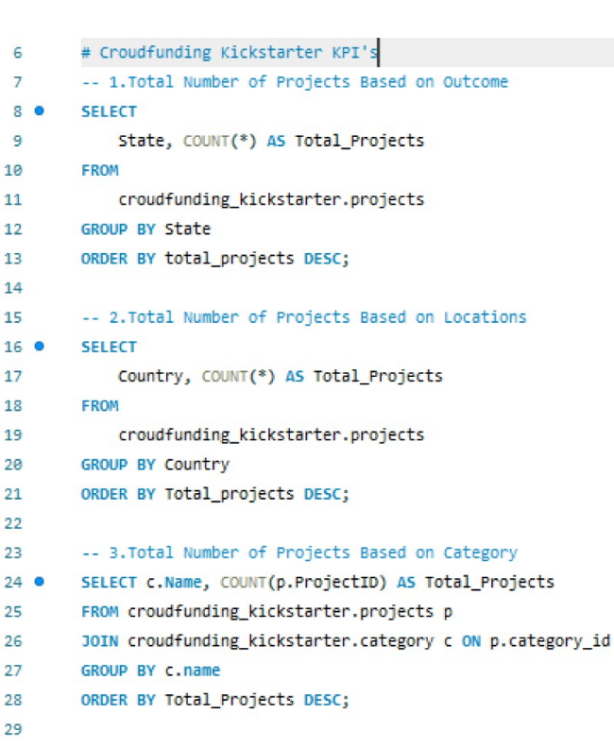
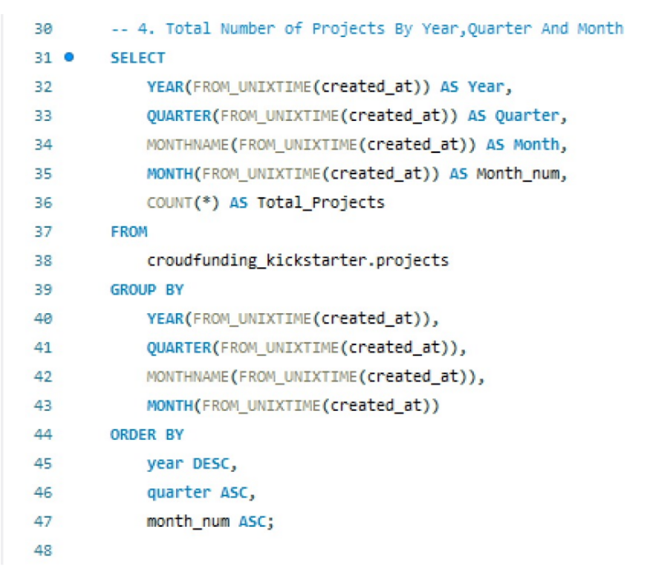
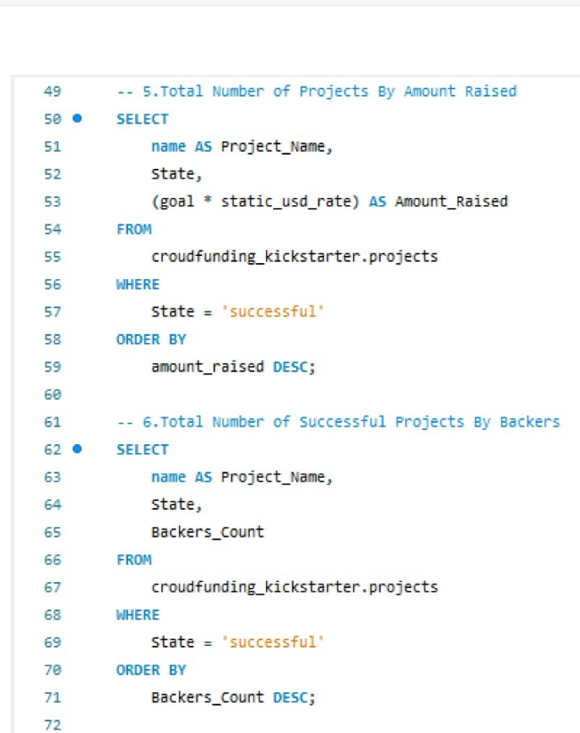
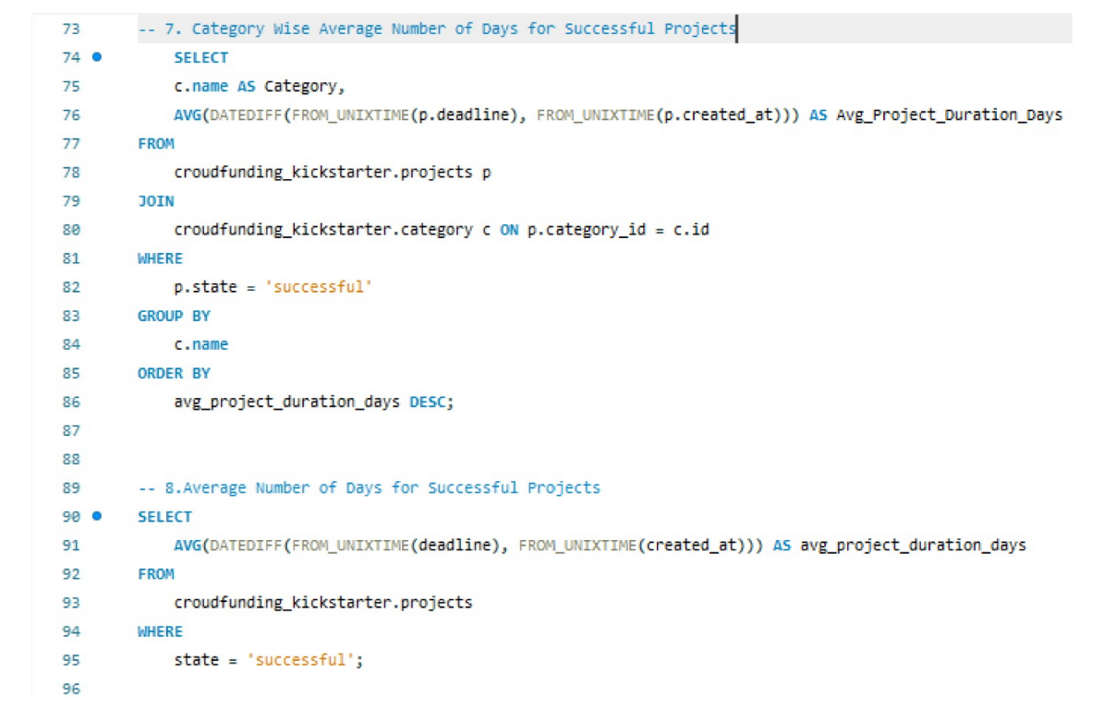
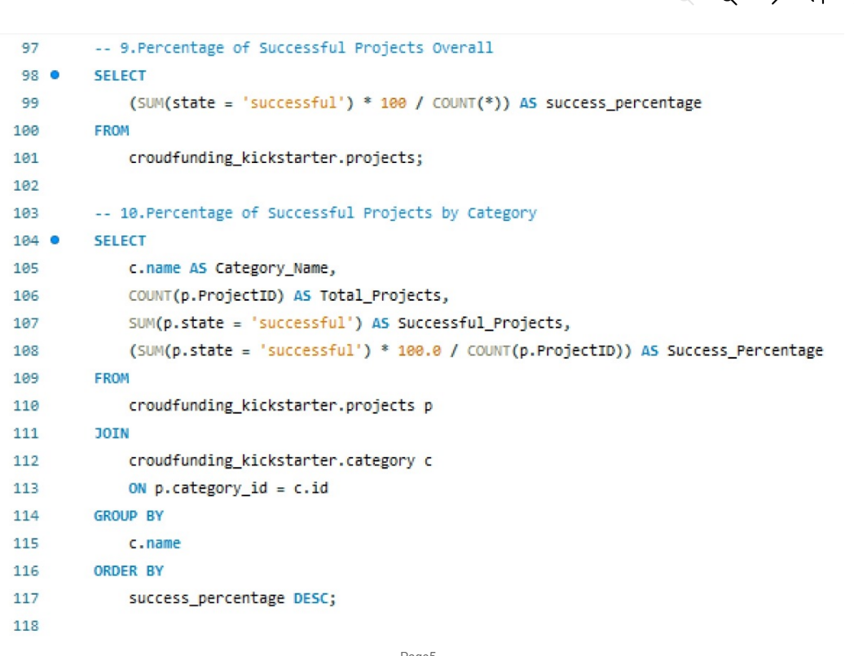
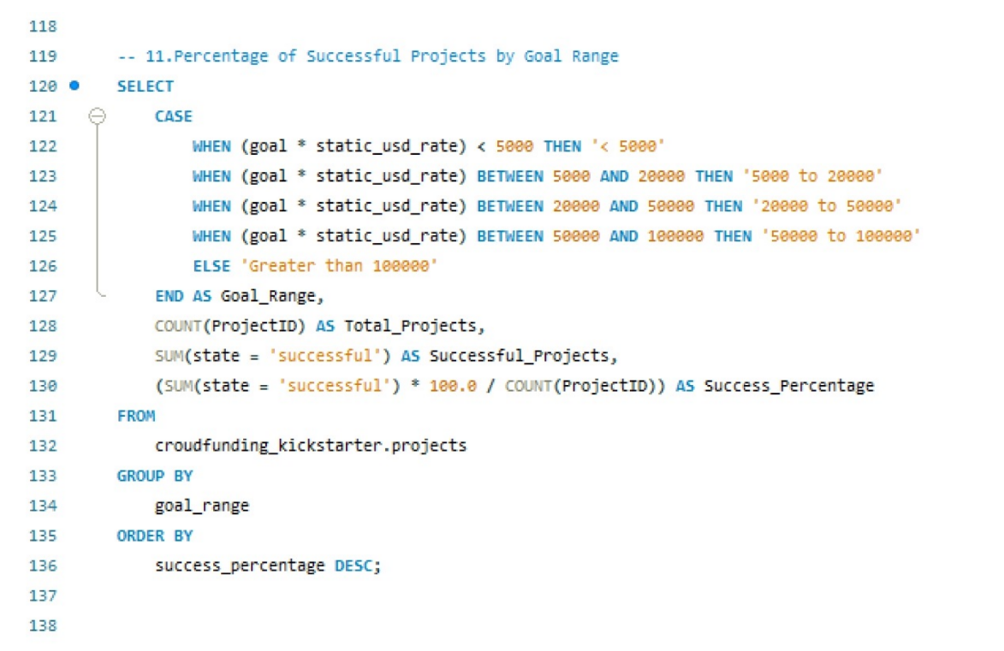
Crowdfunding Analytics – SQL Queries

Slide 8
Executive Performance Snapshot
365.89K
$4.76B
8.35%
2.4M
Total Projects
Amount Raised
Success rate
Total Backers
Analyzed across all categories and regions
Cumulative funding across all campaigns
Analyzed across all categories and regions
Engaged supporters driving project success
These key business metrics provide a comprehensive executive overview of platform performance, setting the foundation for deeper analytical exploration.

Slide 9


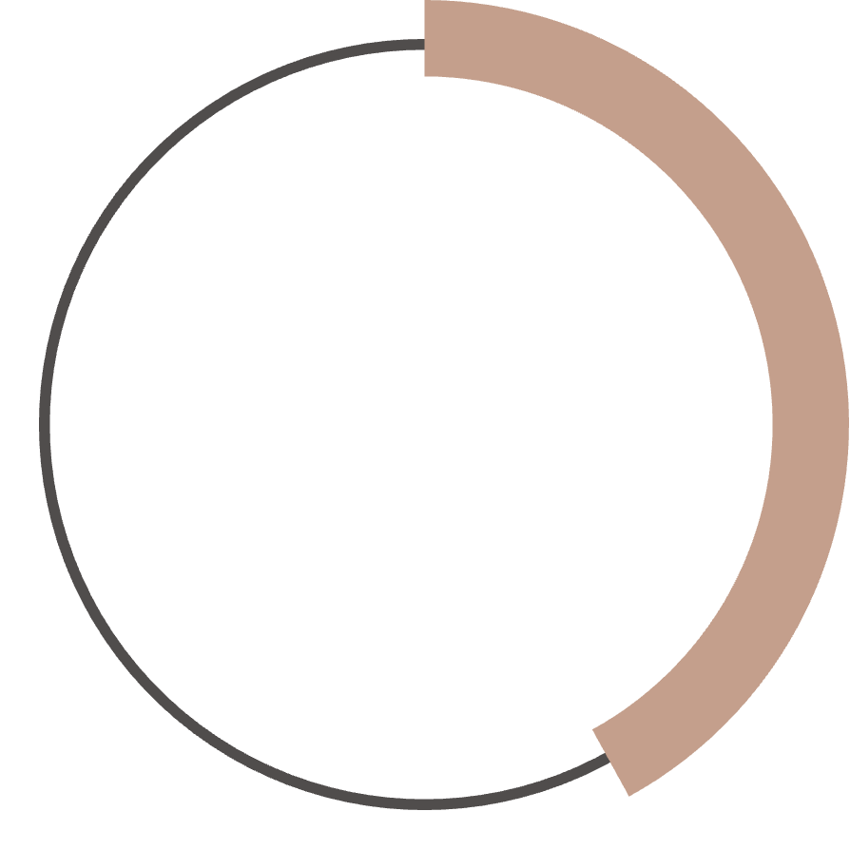
Core Performance Metrics
68%
35
42%
Overall Success Rate
Avg Duration
Tech Category Lead
Percentage of projects meeting funding goals
Days from launch to campaign completion
Highest performing project category

Slide 10
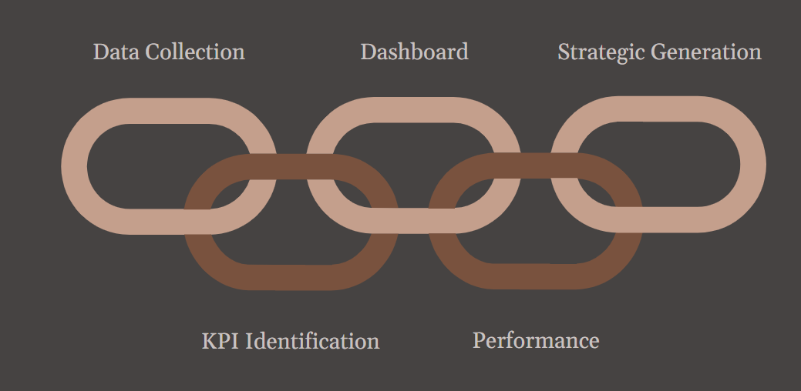
Project Summary: Driving Future Growth
Data Acquisition
Gathered and cleaned crowdfunding datasets covering project details, funding targets, contributors, categories, locations, and timelines to ensure high data quality.
Dashboard
Designed interactive dashboards to track project performance, category trends, regional insights, and time-based patterns for quick decision-making.
Strategic or Insight Generation
Delivered actionable insights to improve campaign strategy, optimize investments, and support future business growth.
KPI Definition
Identified critical KPIs including total campaigns, funds raised, success percentage, average completion time, and total backers.
Performance Analysis
Evaluated success and failure trends across funding goals, categories, and regions to uncover key growth drivers and risk factors.

Slide 11
Conclusion
“This project provides a clear and complete view of how crowdfunding projects perform across different years, countries, and categories. By using Excel, SQL, Power BI, and Tableau, we converted raw project data into meaningful and easy-to-understand insights.
The dashboard highlights total projects, funding amounts, success rates, and backer participation, helping users identify high-performing areas and growth opportunities. It also shows how project trends change over time, which supports better planning and forecasting for future projects.
Overall, this project enables organizations to understand past performance, monitor current trends, and make informed decisions for future crowdfunding success.”

Slide 12

